Slide 1
Team Future Wizards of AI – Assignment A05 Team Members: Gabrielle Marshall (Lead) Bryanna Wallace Daniel Wright Patrick Pacheco Winston Lee

Slide 2
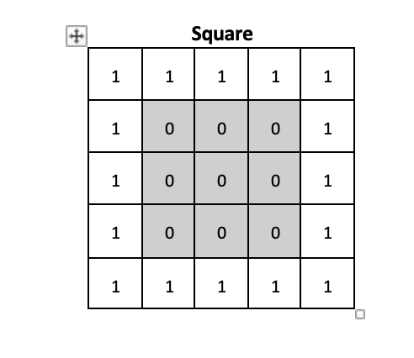
Assignment A05 – Manual CNN

Slide 3
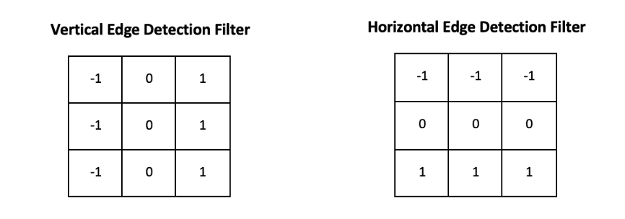
Assignment A05 – Manual CNN

Slide 4
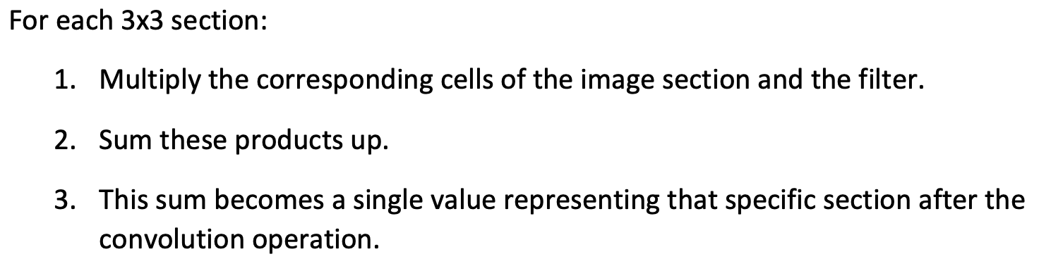
Assignment A05 – Manual CNN
Horizontal Convolution:

Slide 5
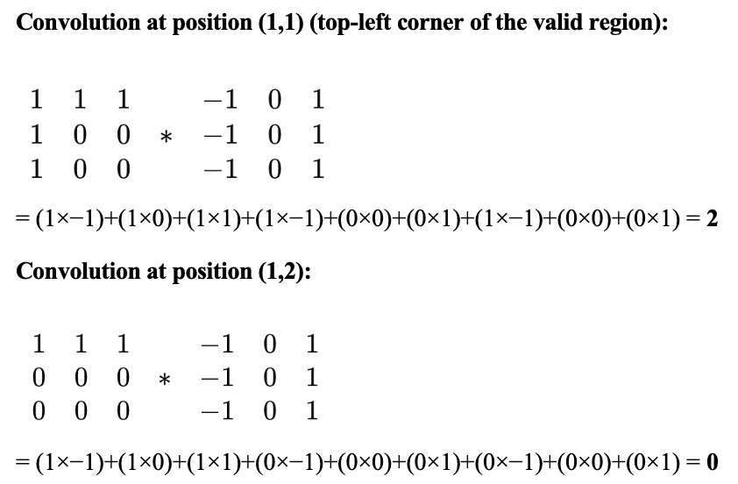
Assignment A05 – Manual CNN

Slide 6
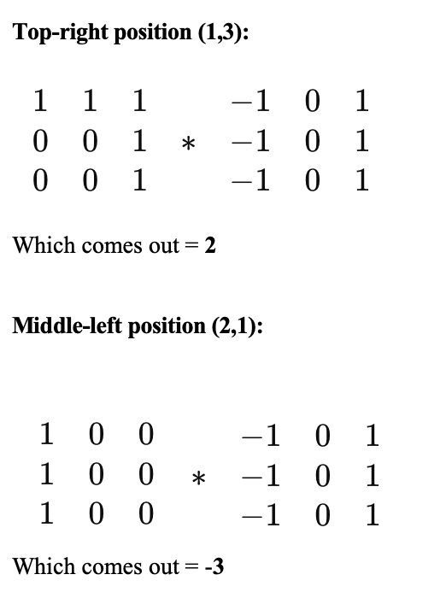
Assignment A05 – Manual CNN

Slide 7
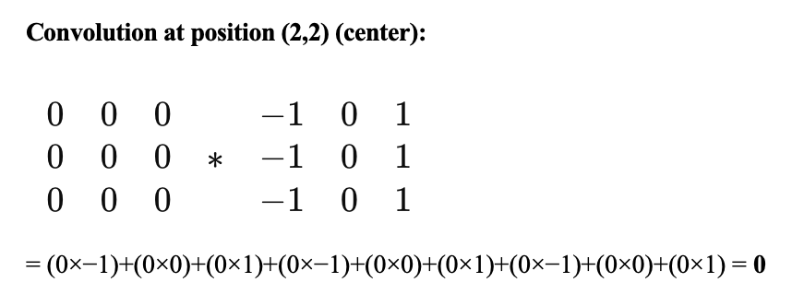
Assignment A05 – Manual CNN

Slide 8
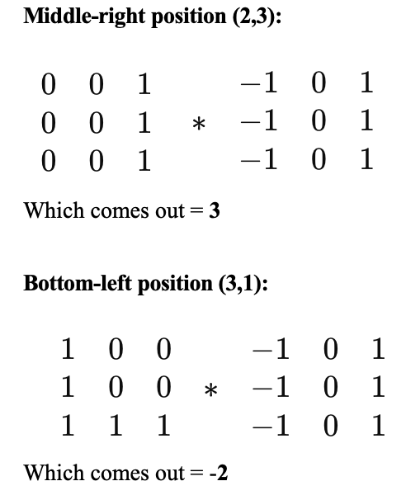
Assignment A05 – Manual CNN

Slide 9
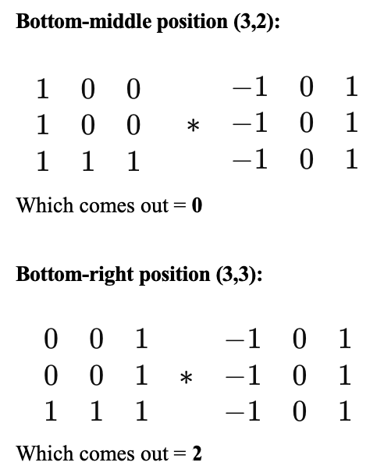
Assignment A05 – Manual CNN

Slide 10
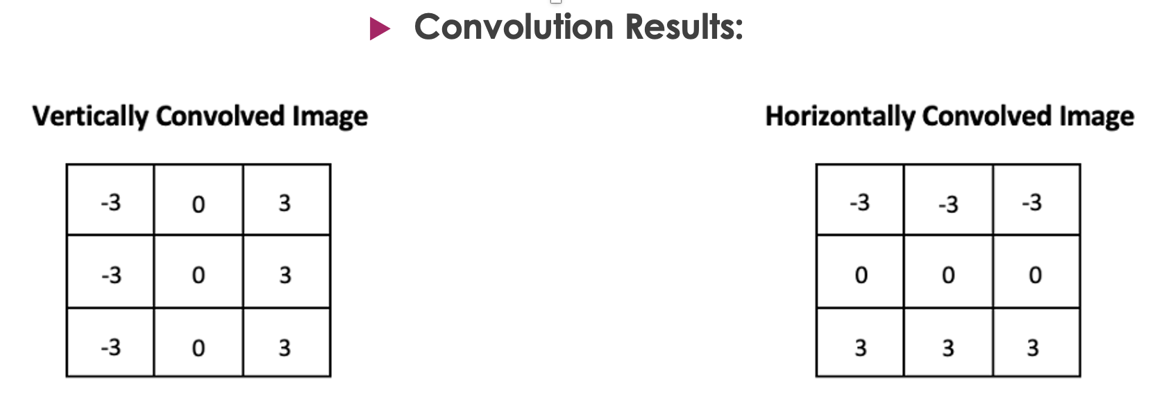
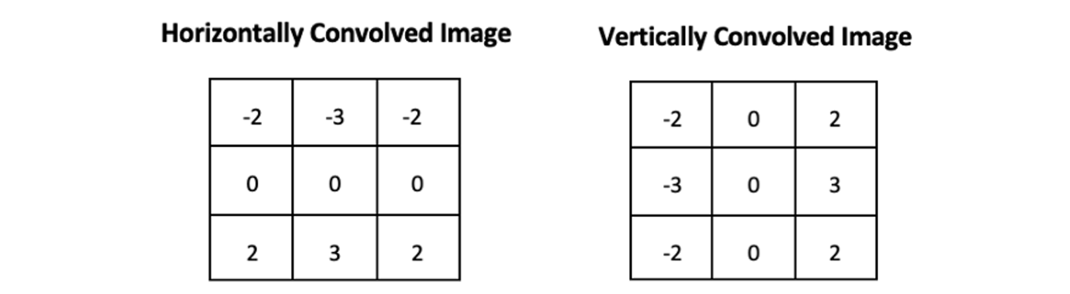
Assignment A05 – Manual CNN

Slide 11
Thank you A-dee-a-dee-a-dee-that’s-all-folks!

